Slide 1
Plane Crashes

Slide 2
Dataset - Struktur
Date: | Date of accident, in the format - January 01, 2001
Time: | Local time, in 24 hr. format unless otherwise specified
Airline/Op: | Airline or operator of the aircraft
Flight #: | Flight number assigned by the aircraft operator
Route: | Complete or partial route flown prior to the accident
AC Type: | Aircraft type
Reg: | ICAO registration of the aircraft
cn / ln: | Construction or serial number / Line or fuselage number
Aboard: | Total aboard (passengers / crew)
Fatalities: | Total fatalities aboard (passengers / crew)
Ground: | Total killed on the ground
Summary: | Brief description of the accident and cause if known

Slide 3
Dataset – Daten 1
Anzahl Records: 5782
Erster Absturz: 17. September 1908
Letzter Absturz: 06. November 2018
Verhältnis Militärisch / Zivil: 15% / 85%
Abstürze in der Schweiz: 23
Abstürze von Schweizer Gesellschaften: 15

Slide 4
Dataset – Daten 2
Fluggesellschaften mit den meisten Abstürzen:
Aeroflot | 260
Air France | 72
Deutsche Lufthansa | 64
United Air Lines | 44
China National Aviation Corporation | 43
Pan American World Airways | 41
American Airlines | 37

Slide 5
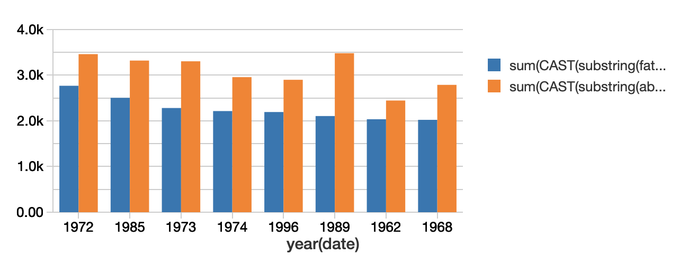
Dataset – Daten 3
Top 8 Jahre mit den meisten Abstürzen:

Slide 6
Dataset – Quellen
Kaggle Link: https://www.kaggle.com/nguyenhoc/plane-crash
http://www.planecrashinfo.com/

